Slide 1


Mark O. Worthington
PMP, SSBB, CEF, CSM
09/25/2024

Slide 2

Outline
Executive Summary
Introduction
Methodology
Results
Conclusion
Appendix

Slide 3
Executive Summary
Spacex Launch and landing success prediction through data analysis –summaries of labs and assignments and a summary of outcomes
Summary of methodologies – api calls, Python, SQL, Python libraries (Beautiful Soup, Folium, Plotly), ect..
Summary of all results – data sets map, Data Summaries, Visualizations, Predictive Analysis

Slide 4
Introduction
Project background and context
Problems you want to find answers

Slide 5

Section 1

Slide 6
Methodology
Executive Summary
Data collection methodology:
Describe how data was collected
Lab1A and Lab1B – Data collection and webscraping
Perform data wrangling
Describe how data was processed
Lab 2
Perform exploratory data analysis (EDA) using visualization and SQL
Perform interactive visual analytics using Folium and Plotly Dash
Perform predictive analysis using classification models
How to build, tune, evaluate classification models

Slide 7
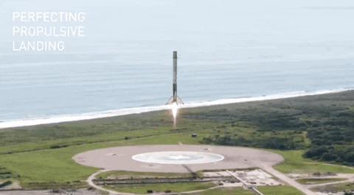

Space X Falcon 9 First Stage Landing Prediction Lab1: Collecting the data
In this capstone, we will predict if the Falcon 9 first stage will land successfully. SpaceX advertises Falcon 9 rocket launches on its website with a cost of 62 million dollars; other providers cost upward of 165 million dollars each, much of the savings is because SpaceX can reuse the first stage. Therefore, if we can determine if the first stage will land, we can determine the cost of a launch. This information can be used if an alternate company wants to bid against SpaceX for a rocket launch. In this lab, you will collect and make sure the data is in the correct format from an API.
Most unsuccessful landings are planned. Space X performs a controlled landing in the oceans.
Objectives
In this lab, you will make a get request to the SpaceX API. You will also do some basic data wrangling and formatting.
Request to the SpaceX API
Clean the requested data

Slide 8
Data Collection – SpaceX API Calls
🚀 Open Source REST API for SpaceX launch, rocket, core, capsule, launchpad, and landing pad data.
Our Objective in this lab is to Collect and Condition data from the Spacex website for a SpaceX Falcon 9 first stage Landing Prediction and to produce a data set that will be used in the data collection module.
We will make 6 calls [GET] to the API at -http://api.spacexdata.com/v4/~
Our first API [GET] call to - spacex_url=https://api.spacexdata.com/v4/launches/past will show us the response information about past SpaceX launches. This information may be dynamic.
Our second API [GET] call to -static_json_url='https://cf-courses-data.s3.us.cloud-object-storage.appdomain.cloud/IBM-DS0321EN-SkillsNetwork/datasets/API_call_spacex_api.json will provide us with static consistent data (w/response code) that can be used to evaluate our responses for the course. The resulting data is converted to a data frame for cleaning and conditioning.
Our third API [GET] call is made via a function to - https://api.spacexdata.com/v4/rockets/ and will provide a list of booster names that will be appended to our data set.
Our fourth API [GET] call is made via a function to - https://api.spacexdata.com/v4/launchpads/ and will provide a list of launch site locations (longitude and Latitude). This will be appended to our data set.
Our fifth API [GET] call is made via a function to - https://api.spacexdata.com/v4/payloads/ and will provide a list of associated payload mass and orbits. This will be appended to our data set.
Our sixth API [GET] call is made via a function to - https://api.spacexdata.com/v4/cores/ and will provide a list of associated information that will be appended to our data set. (i.e. block, reused count, serial, outcome, flights, gridfins, reused, legs, landing pad)
Notes:
Add the GitHub URL of the completed SpaceX API calls notebook (must include completed code cell and outcome cell), as an external reference and peer-review purpose

Slide 9
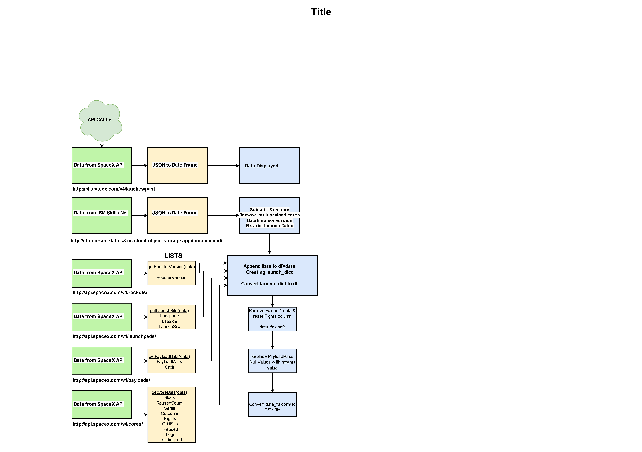
Data Collection – Flowchart
SpaceX API Calls to Final Data Set
SpaceX API calls Notebook – The data collection workspace is completed and stored at - https://github.com/flurpo/IBMspx/blob/main/jupyter-labs-spacex-data-collection-api.ipynb
(This file can be uploaded to the Coursera workspace for Module 1A for review, it can also be reviewed in google colab)
The Final Data Set from the data collection workspace is stored at -https://github.com/flurpo/IBMspx/blob/main/1A_dataset_part_1.csv
Notes:
Present your data collection with SpaceX REST calls using key phrases and flowcharts..
Add the GitHub URL of the completed SpaceX API calls notebook (must include completed code cell and outcome cell), as an external reference and peer-review purpose

Slide 10
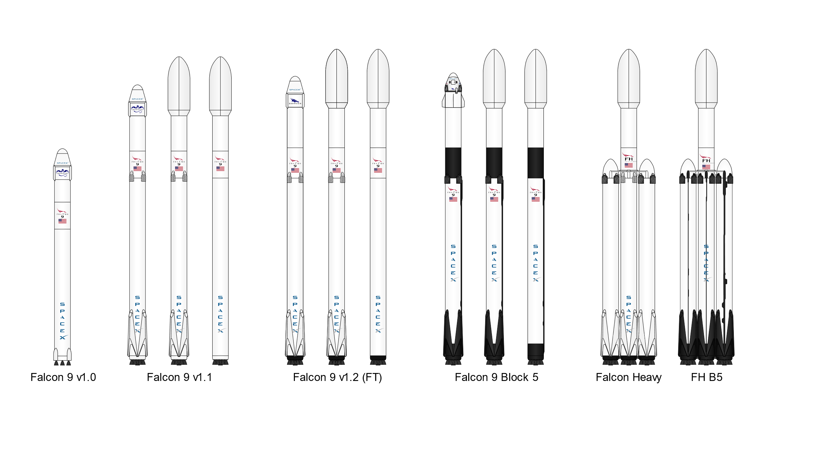
Space X Falcon 9 First Stage Landing Prediction LAB 1B -Web Scraping Falcon 9 and Falcon Heavy Launch Record from Wikipedia
In this lab, you will be performing web scraping to collect Falcon 9 historical launch records from a Wikipedia page titled `List of Falcon 9 and Falcon Heavy launches`
https://en.wikipedia.org/wiki/List_of_Falcon_9_and_Falcon_Heavy_launches
Objectives
Web scrap Falcon 9 launch records with `BeautifulSoup`:
Extract a Falcon 9 launch records HTML table from Wikipedia
Parse the table and convert it into a Pandas data frame

Slide 11
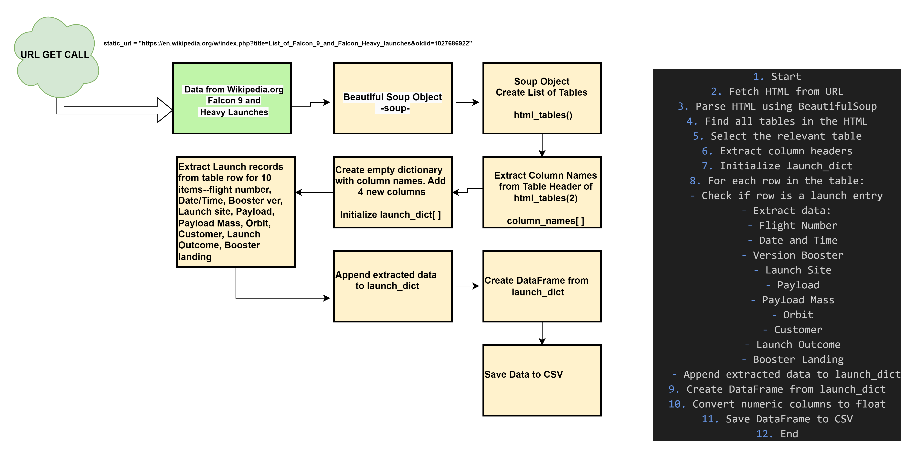
Data Collection – Web Scraping
Web Scraping Falcon 9 records from Wikipedia with Beautiful Soup
The Web Scraping Worksheet –
https://github.com/flurpo/IBMspx/blob/main/jupyter-labs-webscraping.ipynb
The Final Data Set for the Web Scraping Worksheet-
https://github.com/flurpo/IBMspx/blob/main/1B_spacex_web_scraped.csv

Slide 12
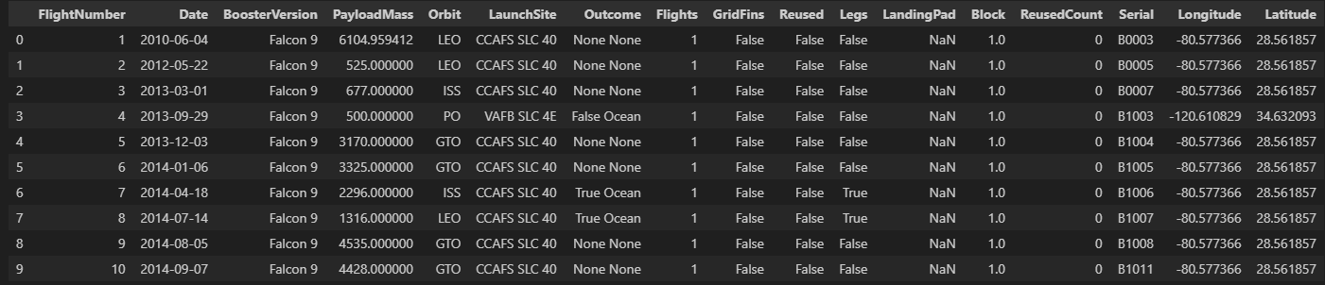
SpaceX Flacon 9 First Stage Landing Prediction Lab 2: Data Wrangling
In this lab, we will perform some Exploratory Data Analysis (EDA) to find some patterns in the data and determine what would be the label for training supervised models. In the data set, there are several different cases where the booster did not land successfully. Sometimes a landing was attempted but failed due to an accident; for example, True Ocean means the mission outcome was successfully landed to a specific region of the ocean while False Ocean means the mission outcome was unsuccessfully landed to a specific region of the ocean. True RTLS means the mission outcome was successfully landed to a ground pad False RTLS means the mission outcome was unsuccessfully landed to a ground pad.True ASDS means the mission outcome was successfully landed on a drone ship False ASDS means the mission outcome was unsuccessfully landed on a drone ship.
In this lab we will mainly convert those outcomes into Training Labels with `1` means the booster successfully landed `0` means it was unsuccessful.
Objectives
Perform exploratory Data Analysis and determine Training Labels

Slide 13
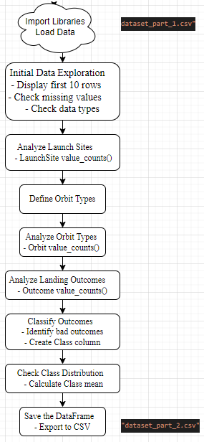
Exploratory Data Analysis, Determine Training labels
See the Data Wrangling flow chart right
Data Wrangling
Task 1 – Calculated the number of launches on each site
Task 2 – Calculated the number and occurrence of each orbit
Task 3 – Calculated the number and occurrence of mission outcome of the orbits
Task 4 – Created a landing outcome label from the Outcome column
The Data Wrangling Worksheet –
https://github.com/flurpo/IBMspx/blob/main/labs-jupyter-spacex-Data wrangling.ipynb
The Data Set Generated from the Data Wrangling Worksheet –
https://github.com/flurpo/IBMspx/blob/main/dataset_part_2.csv

Slide 14
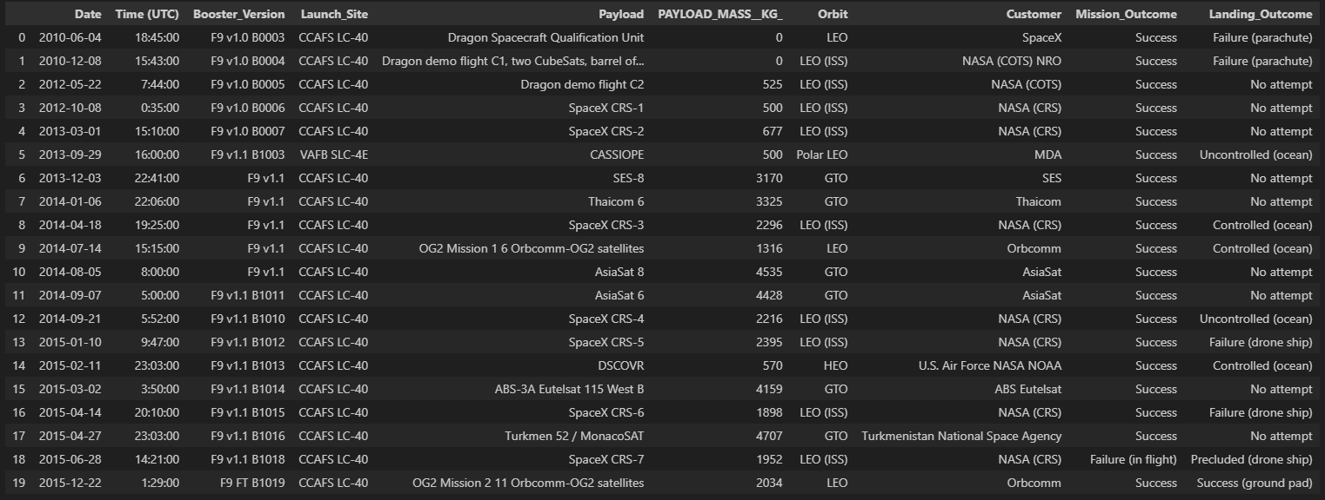
Exploratory Data Analysis with SQL
Overview of the Data Set
https://cf-courses-data.s3.us.cloud-object-storage.appdomain.cloud/IBM-DS0321EN-SkillsNetwork/labs/module_2/data/Spacex.csv
SpaceX has gained worldwide attention for a series of historic milestones. It is the only private company ever to return a spacecraft from low-earth orbit, which it first accomplished in December 2010.SpaceX advertises Falcon 9 rocket launches on its website with a cost of 62 million dollars whereas other providers cost upward of 165 million dollars each, much of the savings is because Space X can reuse the first stage. Therefore, if we can determine if the first stage will land, we can determine the cost of a launch. This information can be used if an alternate company wants to bid against SpaceX for a rocket launch. This dataset includes a record for each payload carried during a SpaceX mission into outer space.

Slide 15
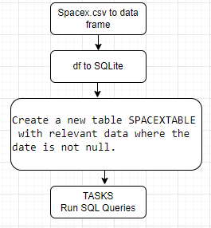
EDA with SQL
Summary of SQL Queries
Task 1: Query for unique launch sites.
Task 2: Query for records with launch sites that start with 'CCA'.
Task 3: Calculate the total payload mass for NASA (CRS) missions.
Task 4: Calculate the average payload mass for booster version F9 v1.1.
Task 5: Use MIN() to find the earliest successful ground pad landing.
Task 6: Query for boosters that succeeded in drone ship landings and had payloads between 4000 and 6000 kg.
Task 7: Count successful, failed, and other mission outcomes.
Task 8: Use a subquery to find the booster version that carried the maximum payload mass.
Task 9: Use SUBSTR() to get month names for landing failures in 2015.
Task 10: Count and rank landing outcomes in a specific date range.
The EDA with SQL Worksheet –
https://github.com/flurpo/IBMspx/blob/main/jupyter-labs-eda-sql-coursera_sqllite.ipynb

Slide 16
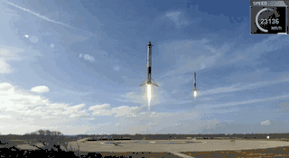
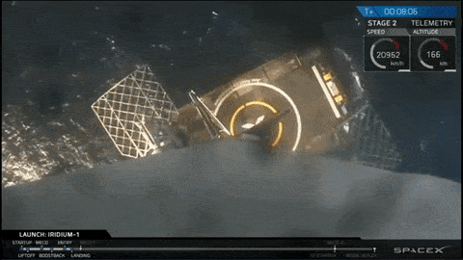
Space X Falcon 9 First Stage Landing Prediction Exploring and Preparing Data – EDA Visualizations and Features Engineering
In this assignment, we will predict if the Falcon 9 first stage will land successfully. SpaceX advertises Falcon 9 rocket launches on its website with a cost of 62 million dollars; other providers cost upward of 165 million dollars each, much of the savings is due to the fact that SpaceX can reuse the first stage.In this lab, you will perform Exploratory Data Analysis and Feature Engineering.
Objectives
Perform exploratory Data Analysis and Feature Engineering using `Pandas` and `Matplotlib`
Exploratory Data Analysis
Preparing Data - Feature Engineering

Slide 17
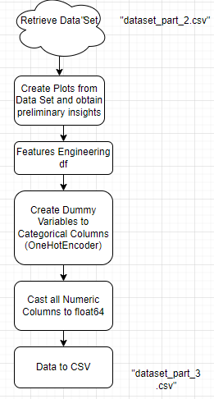
EDA with Data Visualization
Summary of the charts plotted
Flight Number vs Payload Mass – to see how FlightNumber and Payload variables would effect the Launch outcome.
Task 1.. Flight number vs Launch Site – to see how this relationship would effect the Launch outcome.
Task 2.. Visualize the relationship between Payload Mass and Launch Site
Task 3.. Visualize the relationship between Success rate and Orbit type
Task 4.. Visualize the relationship between FlightNumber and Orbit type
Task 5.. Visualize the relationship between Payload Mass and Orbit type
Task 6.. Visualize the launch success yearly trend
EDA with Data Visualization Worksheet –
https://github.com/flurpo/IBMspx/blob/main/edadataviz.ipynb
The Data Set Generated from the Data Visualization Worksheet –
https://github.com/flurpo/IBMspx/blob/main/dataset_part_3.csv

Slide 18
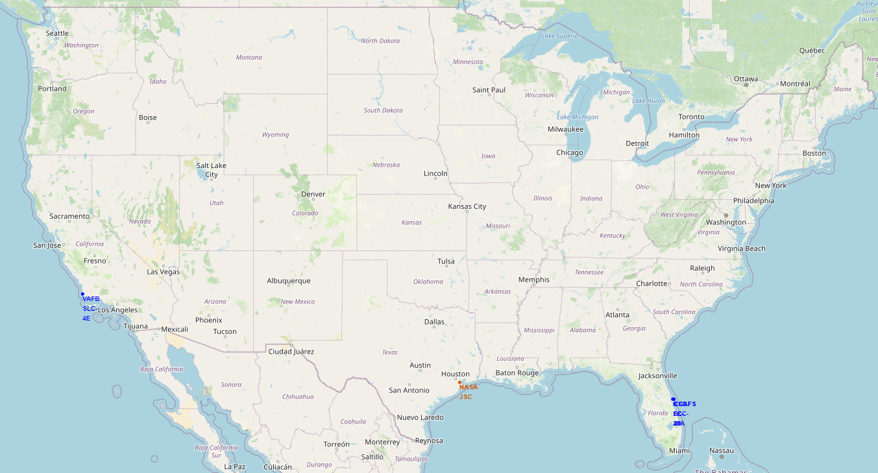
Hands-on Lab: Interactive Visual Analytics with Folium
The launch success rate may depend on many factors such as payload mass, orbit type, and so on. It may also depend on the location and proximities of a launch site, i.e., the initial position of rocket trajectories. Finding an optimal location for building a launch site certainly involves many factors and hopefully we could discover some of the factors by analyzing the existing launch site locations.
Objectives
This lab contains the following tasks:
TASK 1: Mark all launch sites on a map
TASK 2: Mark the success/failed launches for each site on the map
TASK 3: Calculate the distances between a launch site to its proximities
After completed the above tasks, you should be able to find some geographical patterns about launch sites.

Slide 19
Building an Interactive Map with Folium
In the Python Worksheet the following items were added to the Folium Map Generated
Pulled data from spacex_launch_geo.csv
Selected sub columns Launch Site, Latitude, Longitude and class
Create data frames spacex_df(launch site, Lat, Long, class)(56) and launch_sites_df(launch site, Lat, Long) (4)
NOTE- 4 launch sites, three in Florida and one in California
Created a start location at NASA Johnson Sace Center
Created a blue circle at NASA Johnson Space Center's coordinate with a popup label and an icon showing its name
Created an icon as a text label
Added a Circle and Marker to the map for each launch site (4) with the launch site name as a popup label
Added markers (Green, Red) to mark the success/failed launches at each site
Chose a launch site and calculated distance to nearest coastline, city(titusville), railway and highway
Added distance markers and lines
The Folium Worksheet - https://github.com/flurpo/IBMspx/blob/main/Folium.ipynb

Slide 20
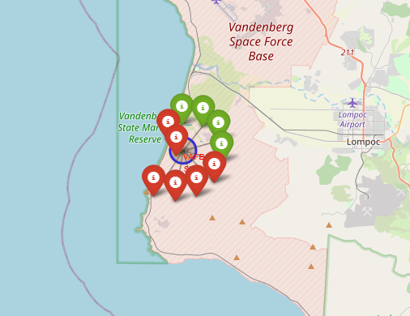
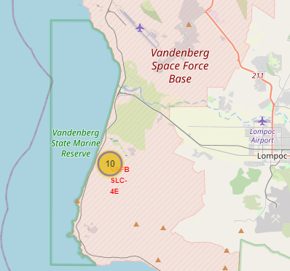
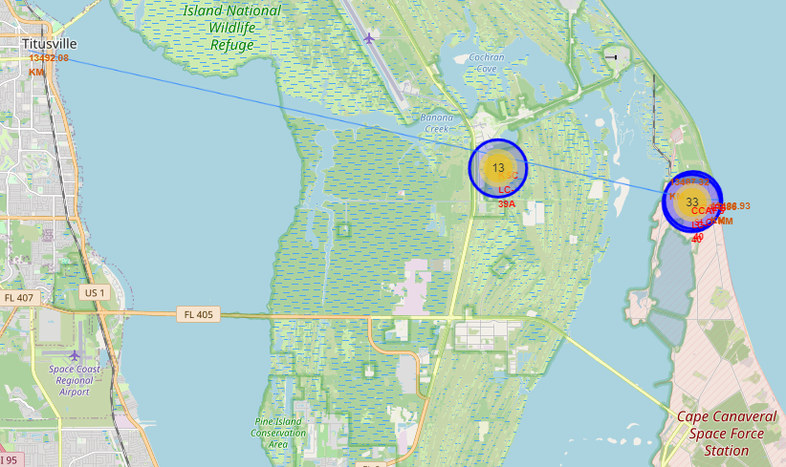
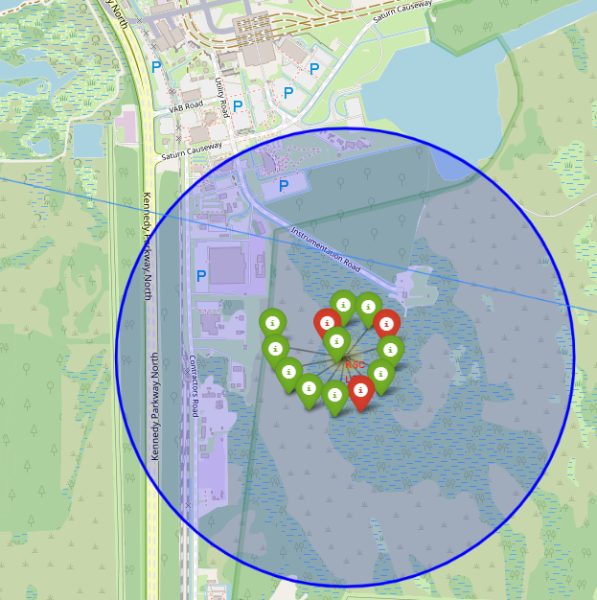
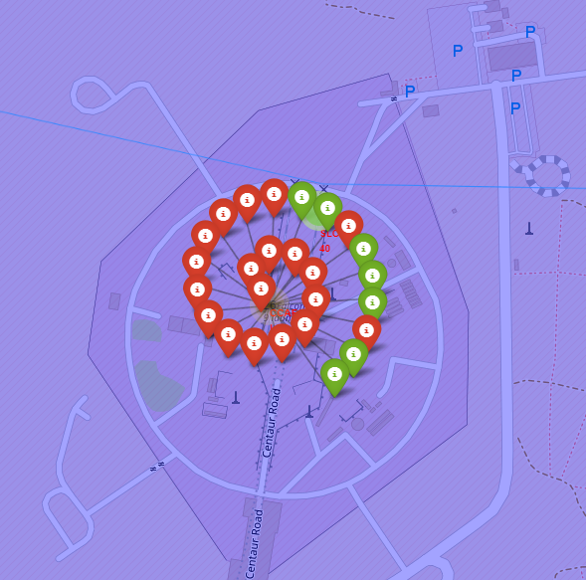
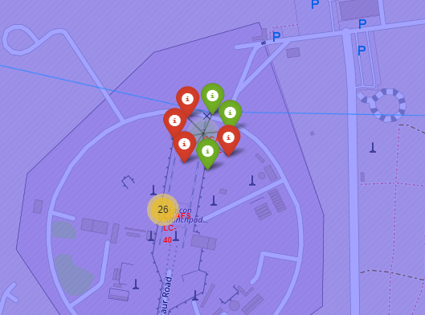
Building an Interactive Map with Folium
 | Launch Site | Lat | Long
0 | CCAFS LC-40 | 28.562302 | -80.577356
1 | CCAFS SLC-40 | 28.563197 | -80.576820
2 | KSC LC-39A | 28.573255 | -80.646895
3 | VAFB SLC-4E | 34.632834 | -120.610745
Stand Alone Folium File (HTML) for inspection in a browser - https://github.com/flurpo/IBMspx/blob/main/site_map.html

Slide 21
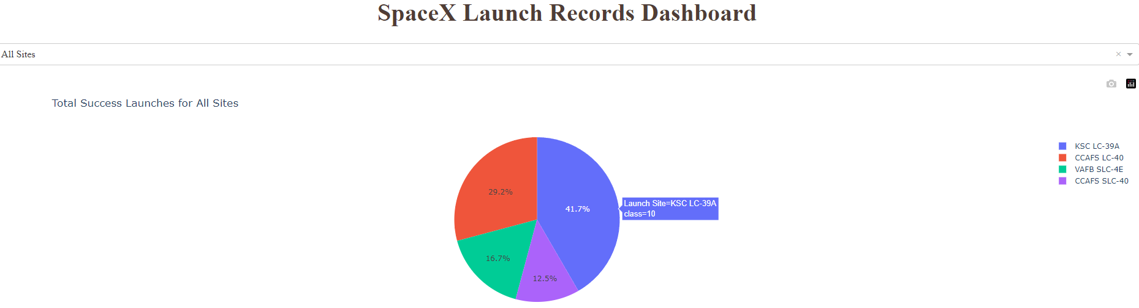
Hands-on Lab: Build an Interactive Dashboard with Ploty Dash
Building a Plotly Dash application for users to perform interactive visual analytics on SpaceX launch data in real-time.
This dashboard application contains input components such as a dropdown list and a range slider to interact with a pie chart and a scatter point chart. You will be guided to build this dashboard application via the following tasks:
TASK 1: Add a Launch Site Drop-down Input Component
TASK 2: Add a callback function to render success-pie-chart based on selected site dropdown
TASK 3: Add a Range Slider to Select Payload
TASK 4: Add a callback function to render the success-payload-scatter-chart scatter plot

Slide 22
Building a Dashboard with Plotly Dash
Plots/graphs and interactions added to the Plotly dashboard
Setup an ngrok tunnel at port '8050’
Loaded data from spacex_launch_dash.cvs to a data frame - spacex_df
Created options for a dropdown ("All Sites', unique launch sites)
Created the dash application and layout
Added dropdown list for launch site selection
Added pie chart to show successful launches for all sites/specific site
Added slider to select payload range for scatter chart
Added scatter chart to show correclation between payload and launch success
Added a callback function for `site-dropdown` as input, `success-pie-chart` as output
Added a callback function for `site-dropdown` as input, `success-pie-chart` as output
The Plotly Dashboard Notebook - https://github.com/flurpo/IBMspx/blob/main/spacex_dash_app_20240914.ipynb
The Plotly Dashboard App to run as a standalone Python application through a browser -

Slide 23
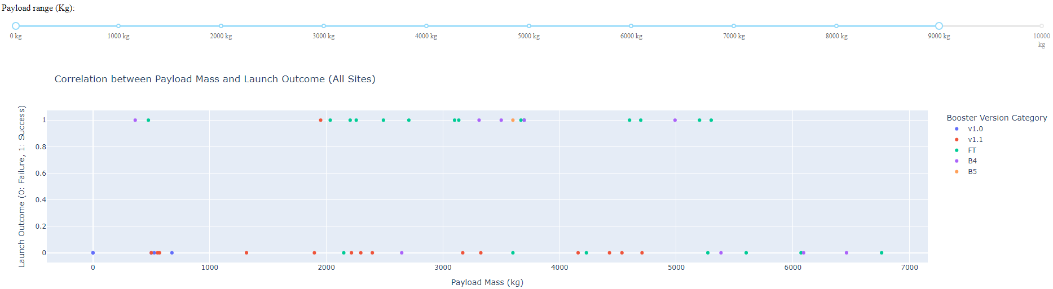
Building a Dashboard with Plotly Dash
PDF of Plotly Dashboard - https://github.com/flurpo/IBMspx/blob/main/Plotly_spacex_dash_app_20240914.pdf

Slide 24
Space X Falcon 9 First Stage Landing Prediction Machine Learning Prediction
Objectives
Perform exploratory Data Analysis and determine Training Labels
create a column for the class
Standardize the data
Split into training data and test data
-Find best Hyperparameter for SVM, Classification Trees and Logistic Regression
Find the method performs best using test data

Slide 25
Predictive Analysis (Classification)
I built, evaluated, improved, and found the best performing classification model using the following steps
Created a confusion matrix plot function
Loaded dataset_part_2.csv to dataframe "data"
Loaded dataset_part_3.csv to dataframe "X"
Created a Training data set and a Testing data set
Used LOGISTIC REGRESSION estimation on data - calculated hyperparameters, calculated accuracy, ploted confusion matrix
Used SUPPORT VECTOR MACHINE estimation on data - calculated hyperparameters, calculated accuracy, ploted confusion matrix
Used DECISION TREE CLASSIFIER estimation on data - calculated hyperparameters, calculated accuracy, ploted confusion matrix
Used KNEIGHBORS CLASSIFIER estimation on data - calculated hyperparameters, calculated accuracy, ploted confusion matrix
Created a Summary Generator for the resulting data
Predictive Analysis Worksheet - https://github.com/flurpo/IBMspx/blob/main/Module4_Spacex_Machine_learning_Prediction.ipynb

Slide 26
Predictive analysis results
Results
Calculated Accuracy Results for Logistic Regression
tuned hyperparameters :(best parameters) {'C': 0.01, 'penalty': 'l2', 'solver': 'lbfgs'}
accuracy : 0.8464285714285713
Logistic Regression Test Accuracy: 0.8333333333333334
Calculated Accuracy Results for Support Vector Machine
tuned hyperparameters :(best parameters) {'C': 1.0, 'gamma': 0.03162277660168379, 'kernel': 'sigmoid'}
accuracy : 0.8482142857142856
Support Vector Machine Test Accuracy: 0.8333333333333334
Calculated Accuracy Results for Decision Tree
tuned hyperparameters :(best parameters) {'criterion': 'entropy', 'max_depth': 4, 'max_features': 'log2', 'min_samples_leaf': 1, 'min_samples_split': 2, 'splitter': 'best'}
accuracy : 0.9035714285714287
Decision Tree Test Accuracy: 0.8333333333333334
removed 'auto' from 'max_features' in parameters - not a valid option in DecisionTreeClassifier
Calculated Accuracy Results for K-Nearest Neighbors
tuned hyperparameters :(best parameters) {'algorithm': 'auto', 'n_neighbors': 10, 'p': 1}
accuracy : 0.8482142857142858
K-Nearest Neighbors Test Accuracy: 0.8333333333333334
IN SUMMARY:
The test data accuracy and confusion matrix response was identical across the model results. So, its very difficult to chose a best model based on the test accuracy.
SVM is likely to perform the best overall on this dataset due to its strength in handling high-dimensional data and non-linear relationships.
However, Logistic Regression could also be a strong contender if the relationships between the features and the target are mostly linear.
KNN should be the worst performer as it is less effective with High-dimensional data.
CONCLUSION:
Although all of the models had identical test accuracy, the DECISION TREE CLASSIFIER has a higher fit accuracy - 0.9036 and better confusion matrix response. It is our best model with this limited data set

Slide 27
Results
Exploratory Data Analysis Results
Summary of SQL Queries
1: Query for unique launch sites.
2: Query for records with launch sites that start with 'CCA’.
3: Calculate the total payload mass for NASA (CRS) missions
4: Calculate the average payload mass for booster version F9 v1.1.
5: Use MIN() to find the earliest successful ground pad landing
6: Query for boosters that succeeded in drone ship landings and had payloads between 4000 and 6000 kg.
7: Count successful, failed, and other mission outcomes.
8: Use a subquery to find the booster version that carried the maximum payload mass.
9: Use SUBSTR() to get month names for landing failures in 2015.
10: Count and rank landing outcomes in a specific date range.
Summary of the charts plotted
Flight Number vs Payload Mass – to see how FlightNumber and Payload variables would effect the Launch outcome.
1.. Flight number vs Launch Site – to see how this relationship would effect the Launch outcome.
2.. Visualize the relationship between Payload Mass and Launch Site
3.. Visualize the relationship between Success rate and Orbit type
4.. Visualize the relationship between FlightNumber and Orbit type
5.. Visualize the relationship between Payload Mass and Orbit type
6.. Visualize the launch success yearly trend

Slide 28
Results
Interactive analytics demo in screenshots
PDF of Plotly Dashboard - https://github.com/flurpo/IBMspx/blob/main/Plotly_spacex_dash_app_20240914.pdf
Folium App - https://github.com/flurpo/IBMspx/blob/main/site_map.html

Slide 29

Section 2

Slide 30
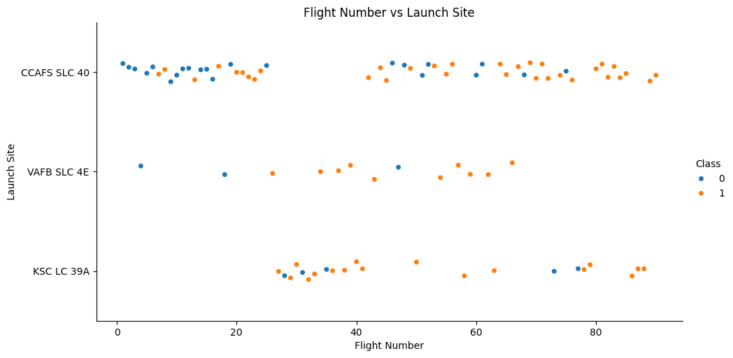
Flight Number vs. Launch Site
I see that the majority moved of launches moved from Launch Site SLC40 to Site KSC LC 39A during flight numbers f#25-40 .
The overall Majority of Launches have occurred at site CCAFS SLC 40.

Slide 31
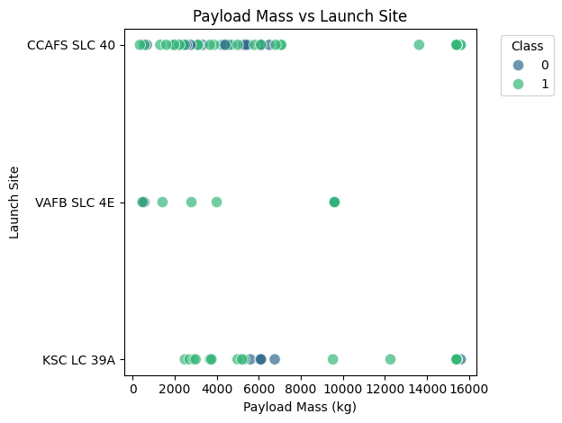
Payload vs. Launch Site
The most launches occur at CCAFS SLC 40
The least and lowest payload launches occur at VAFB SLC 4E
I see the heaviest launch failure at KSC LC 39A

Slide 32
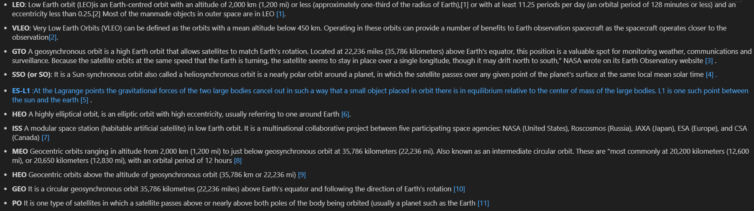
Success Rate vs. Orbit Type
Each Launch aims to a dedicated orbit. Here are some common orbit types:

Slide 33
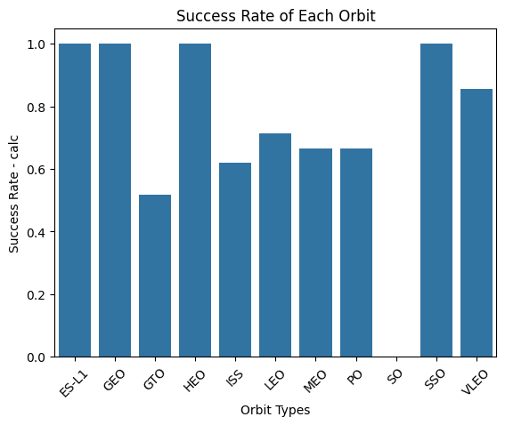
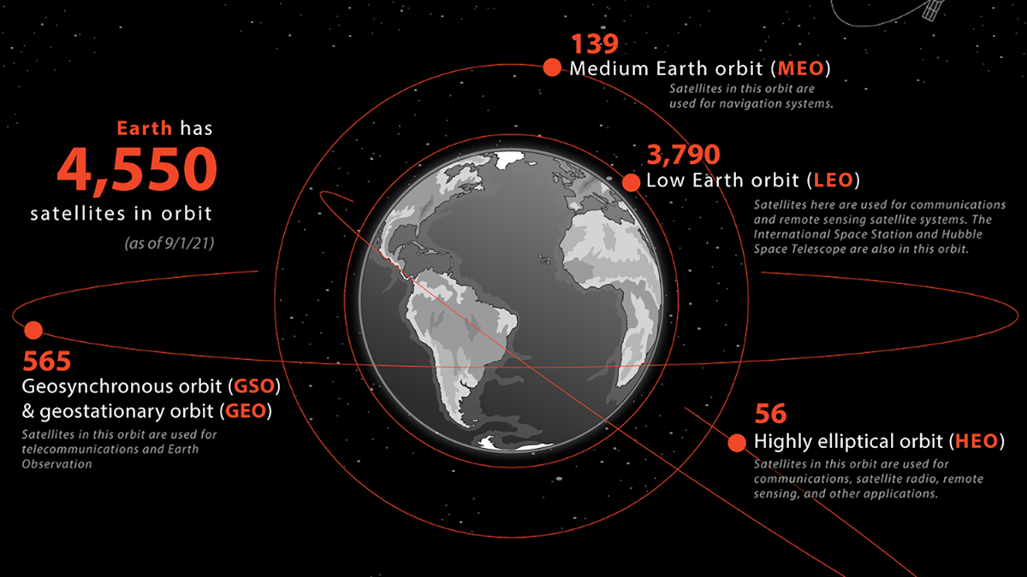
Success Rate vs. Orbit Type
ES-L1 (Earth-Sun Lagrange point 1), GEO, HEO and SSO (Sun-Synchronous Orbit) have perfect launch records
GTO(Geostationary Transfer Orbit) is associated with the lowest launch success rate
No launch data in this data set for SO

Slide 34
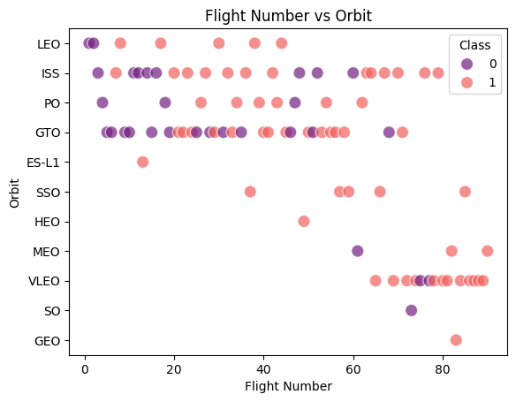
Flight Number vs. Orbit Type
Most of the Early Flights (<20) involved launch failures.
Most of the later Flights (>60) where associated with VLEO (very low earth orbit)
You can observe that in the LEO orbit, success seems to be related to the number of flights. Conversely, in the GTO orbit, there appears to be no relationship between flight number and success.

Slide 35
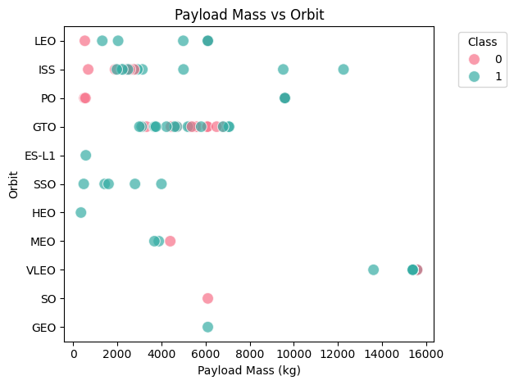
Payload vs. Orbit Type
With heavy payloads the successful landing or positive landing rate are more for Polar,LEO and ISS.
However, for GTO, it's difficult to distinguish between successful and unsuccessful landings as both outcomes are present.

Slide 36
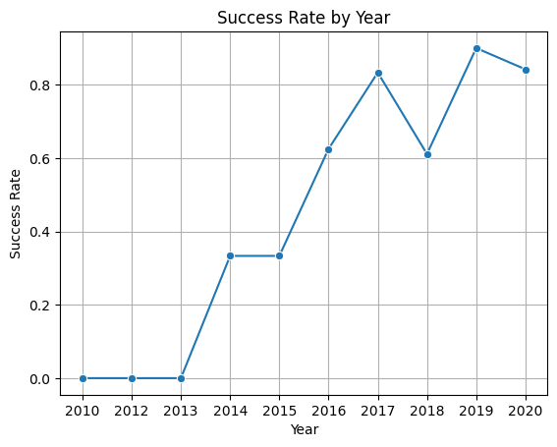
Launch Success Yearly Trend
you can observe that the sucess rate since 2013 kept increasing till 2020

Slide 37
All Launch Site Names
Find the names of the unique launch sites
[('CCAFS LC-40',), ('VAFB SLC-4E',), ('KSC LC-39A',), ('CCAFS SLC-40',)]
CALCULATED BY Select DISTINCT Launch_Site FROM SPACEXTABLE

Slide 38
Launch Site Names Begin with 'CCA'
Find 5 records where launch sites begin with `CCA`
('2010-06-04', '18:45:00', 'F9 v1.0 B0003', 'CCAFS LC-40', 'Dragon Spacecraft Qualification Unit', 0, 'LEO', 'SpaceX', 'Success', 'Failure (parachute)’)
('2010-12-08', '15:43:00', 'F9 v1.0 B0004', 'CCAFS LC-40', 'Dragon demo flight C1, two CubeSats, barrel of Brouere cheese', 0, 'LEO (ISS)', 'NASA (COTS) NRO', 'Success', 'Failure (parachute)’)
('2012-05-22', '7:44:00', 'F9 v1.0 B0005', 'CCAFS LC-40', 'Dragon demo flight C2', 525, 'LEO (ISS)', 'NASA (COTS)', 'Success', 'No attempt’)
('2012-10-08', '0:35:00', 'F9 v1.0 B0006', 'CCAFS LC-40', 'SpaceX CRS-1', 500, 'LEO (ISS)', 'NASA (CRS)', 'Success', 'No attempt’)
('2013-03-01', '15:10:00', 'F9 v1.0 B0007', 'CCAFS LC-40', 'SpaceX CRS-2', 677, 'LEO (ISS)', 'NASA (CRS)', 'Success', 'No attempt')
CALCULATED BY SELECTING * FROM SPACEXTABLE WHERE Launch_Site LIKE 'CCA%' LIMIT 5

Slide 39
Total Payload Mass
Calculate the total payload carried by boosters from NASA
Total Payload Mass for NASA (CRS) missions: 45596 KG
CALCULATED BY SELECTING PAYLOAD_MASS__KG_ FROM SPACEXTABLE WHERE Customer = 'NASA (CRS)'

Slide 40
Average Payload Mass by F9 v1.1
Calculate the average payload mass carried by booster version F9 v1.
(3170,)(3325,) (2296,) (1316,) (4535,)
Average Payload Mass for Booster_Version F9 v1.1: 2928.4 KG
Calculated by SELECTING PAYLOAD_MASS__KG_ FROM SPACEXTABLE WHERE Booster_Version = 'F9 v1.1'

Slide 41
First Successful Ground Landing Date
Find the dates of the first successful landing outcome on ground pad
Earliest Successful Ground Pad Landing: 2015-12-22
CALCULATED BY SELECT MIN(Date) FROM SPACEXTABLE WHERE Landing_Outcome = 'Success (ground pad)'

Slide 42
Successful Drone Ship Landing with Payload between 4000 and 6000
List the names of boosters which have successfully landed on drone ship and had payload mass greater than 4000 but less than 6000
Names of the boosters which have success in drone ship and have payload mass greater than 4000 but less than 6000: F9 FT B1022
CALCULATED BY SELECT DISTINCT(Booster_Version) FROM SPACEXTABLE WHERE Landing_Outcome = 'Success (drone ship)' AND PAYLOAD_MASS__KG_ > 4000 AND PAYLOAD_MASS__KG_ < 6000

Slide 43
Total Number of Successful and Failure Mission Outcomes
Calculate the total number of successful and failure mission outcomes
Rows in Table SPACEXTABLE: 101
Successful Mission Outcome: 98
Failure Mission Outcome: 1
Other Mission Outcome: 2
CALCULATED BY:
SELECT COUNT(*) FROM SPACEXTABLE WHERE Mission_Outcome = 'Success’
SELECT COUNT(*) FROM SPACEXTABLE WHERE Mission_Outcome LIKE 'Failure%’
SELECT COUNT(*) FROM SPACEXTABLE WHERE Mission_Outcome != 'Success' AND Mission_Outcome NOT LIKE 'Failure%'

Slide 44
Boosters Carried Maximum Payload
List the names of the booster which have carried the maximum payload mas
Booster versions MAX Payload: F9 B5 B1048.4
CALCULATED BY:
SELECT Booster_Version
FROM SPACEXTABLE
WHERE PAYLOAD_MASS__KG_ = (
SELECT MAX(PAYLOAD_MASS__KG_)
FROM SPACEXTABLE)

Slide 45
2015 Launch Records
List the failed landing_outcomes in drone ship, their booster versions, and launch site names for in year 2015
('January', 'F9 v1.1 B1012', 'CCAFS LC-40', 'Failure (drone ship)’)
('April', 'F9 v1.1 B1015', 'CCAFS LC-40', 'Failure (drone ship)')
CALC BY:
SELECT
CASE SUBSTR(Date, 6, 2)
WHEN '01' THEN 'January'
WHEN '02' THEN 'February'
WHEN '03' THEN 'March'
WHEN '04' THEN 'April'
WHEN '05' THEN 'May'
WHEN '06' THEN 'June'
WHEN '07' THEN 'July'
WHEN '08' THEN 'August'
WHEN '09' THEN 'September'
WHEN '10' THEN 'October'
WHEN '11' THEN 'November'
WHEN '12' THEN 'December'
END AS Month_Name,
Booster_Version,
Launch_Site,
Landing_Outcome
FROM SPACEXTABLE
WHERE Landing_Outcome = 'Failure (drone ship)'
AND SUBSTR(Date, 0, 5) = '2015'

Slide 46
Rank Landing Outcomes Between 2010-06-04 and 2017-03-20
Rank the count of landing outcomes (such as Failure (drone ship) or Success (ground pad)) between the date 2010-06-04 and 2017-03-20, in descending order
('No attempt', 10)
('Success (drone ship)', 5)
('Failure (drone ship)', 5)
('Success (ground pad)', 3)
('Controlled (ocean)', 3)
('Uncontrolled (ocean)', 2)
('Failure (parachute)', 2)
('Precluded (drone ship)', 1)
CALC BY
SELECT Landing_Outcome, COUNT(*) AS Outcome_Count
FROM SPACEXTABLE
WHERE Date BETWEEN '2010-06-04' AND '2017-03-20'
GROUP BY Landing_Outcome
ORDER BY Outcome_Count DESC

Slide 47

Section 3

Slide 48
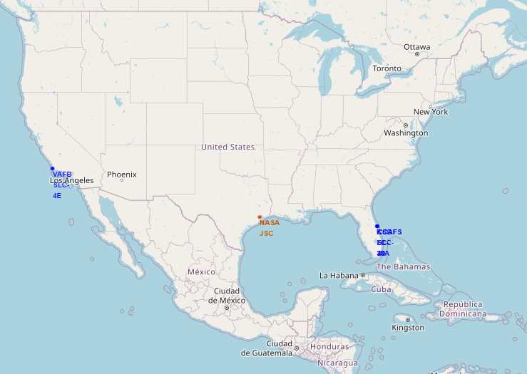
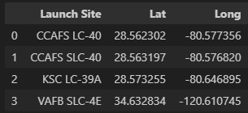
Launch Sites- Folium Map
Note:
One Launch Site at Vandenburg AireForce Base in California
Two Launch Sites at Cape Canaveral Space Launch Complex in Florida
One Launch Site at the Kennedy Space Center in Florida

Slide 49
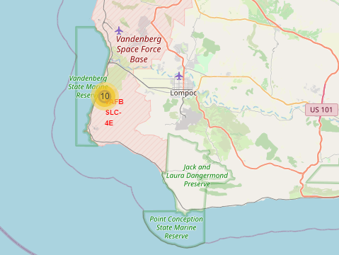
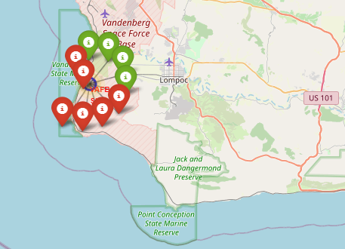
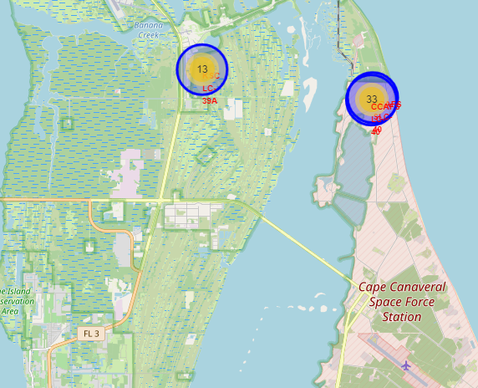
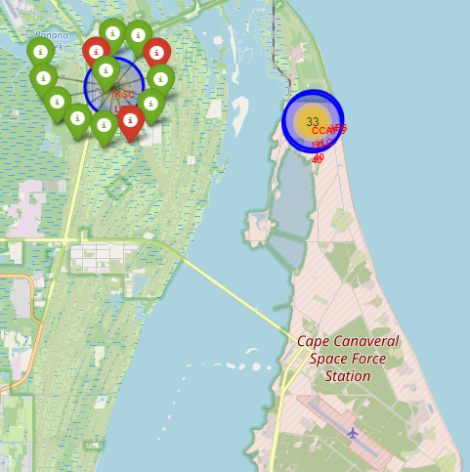
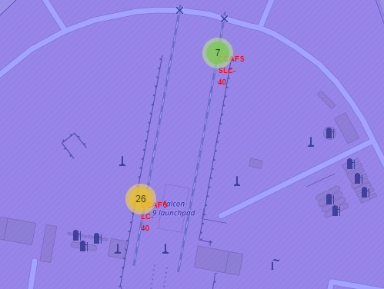
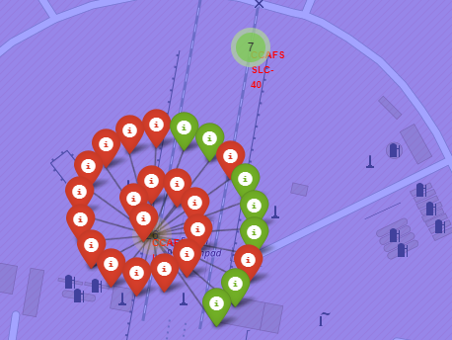
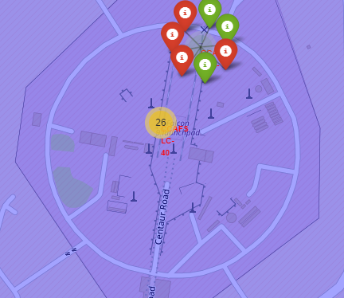
Interactive Launch Information - Folium Map
VAFB SLC 4E /10 Launches
VAFB SLC 4E (4 successful Launches, 6 failures)
KSC LC 39A/13 Launches
CCAFS SLC&LC 40/33 Launches
KSC LC 39A(10 successful Launches, 3 failures)
CCAFS LC 40/26 Launches
CCAFS SLC 40/7 Launches
CCAFS LC 40/8 successful Launches, 18 failures)
CCAFS SLC 40/7 Launches
BLUE CIRCLE - LAUNCH SITE
YELLOW CIRCLE – SITE LAUNCH COUNT MIXED
GREEN CIRCLE – SITE LAUNCH ALL SUCCESSFUL
GREEN TAGS – SUCCESSFUL LAUNCHES
RED TAGS – UNSUCCESSFUL LAUNCHES

Slide 50
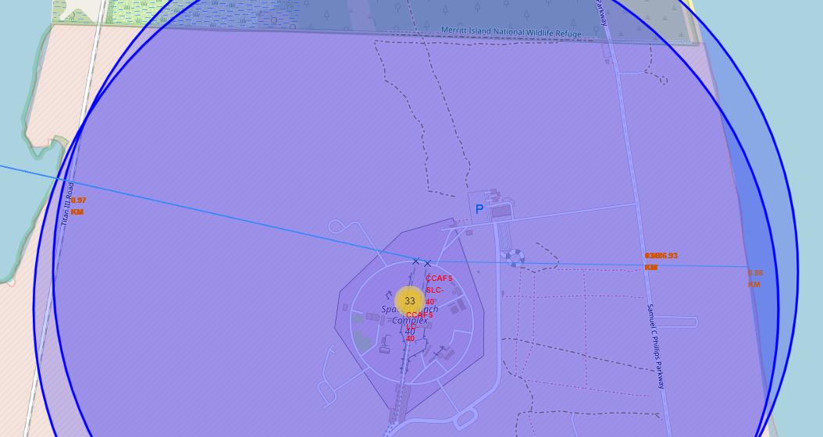
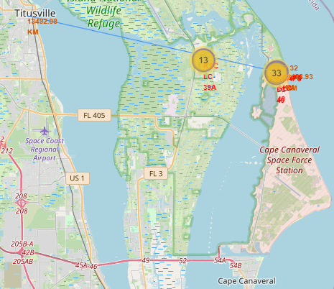
Calculated Distances and markings - Folium Map
CCAFS SLC 40 to Coastline – 0.86 KM
CCAFS SLC 40 to Parkway – 0.586 KM
CCAFS SLC 40 to Railway – 0.972 KM
CCAFS SLC 40 to Titusville – 23.89 KM

Slide 51

Section 4

Slide 52
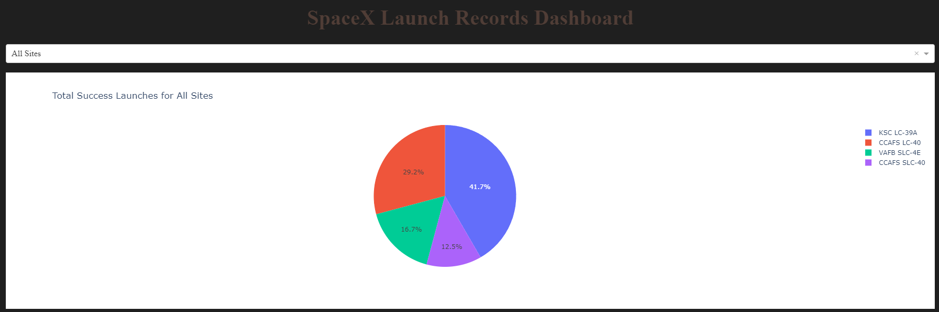
Dashboard Application – PIE CHART – Successful Launches All Sites
Launch success in the early years (first 56 launches) was marginal.
KSC LC – 39A represented the largest percentage of the total successful launches.

Slide 53
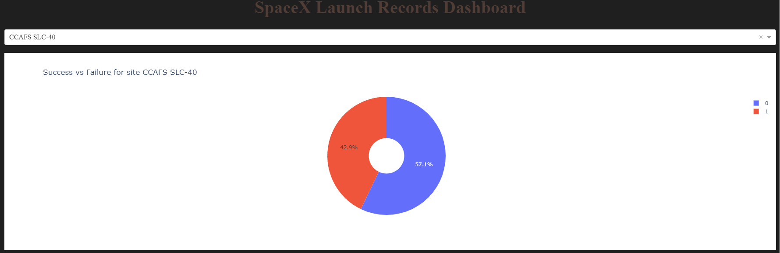
Dashboard Application – PIE CHART – Highest Launch Success Ratio
Show the screenshot of the piechart for the launch site with highest launch success ratio
Though KSC LC-39A was responsible for the highest percentage of success across the launch sites, CCAFS SLC-40 had the highest launch success ratio.

Slide 54
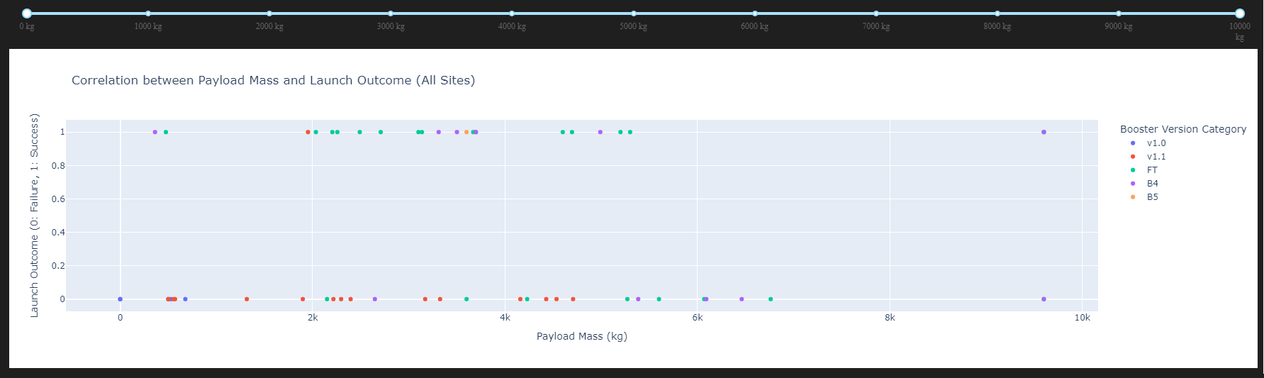
Dashboard Application – SCATTER PLOT– All Site/Full Payload Range
Across all Sites:
Booster Version FT was the most successful
Booster Version v1.1 was the least successful
Booster Version B4 was successfully launched with the highest payload mass

Slide 55

Section 5

Slide 56
Classification Accuracy
The DECISION TREE model has the highest classification accuracy

Slide 57
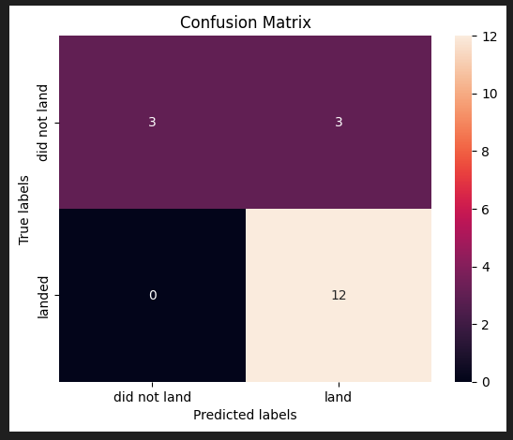
Confusion Matrix
The test data accuracy and confusion matrix response was identical across the model results. Likely because of the lack of data and differentiation in the data. So, its very difficult to chose a best model based on the test accuracy
Accuracy: (TP + TN) / (TP + TN + FP + FN) = 0.8333333
Precision: TP / (TP + FP) = 0.8
Recall (Sensitivity): TP / (TP + FN) = 0.8
Specificity: TN / (TN + FP) = 0.5
F1-Score: 2 * (Precision * Recall) / (Precision + Recall)
= 0.8

Slide 58
Conclusions
IN SUMMARY: The test data accuracy and confusion matrix response was identical across the model results. So, its very difficult to chose a best model based on the test accuracy. This is likely because of the small data set.
SVM is likely to perform the best overall on this dataset due to its strength in handling high-dimensional data and non-linear relationships.
However, Logistic Regression could also be a strong contender if the relationships between the features and the target are mostly linear.
KNN should be the worst performer as it is less effective with High-dimensional data.
CONCLUSION: The Cross-validation results (GridSearchCV) should be considered as this is the best performer on the dataset.
Based on that weight I would choose the DECISION TREE CLASSIFIER as the best performer as it has the highest GridSearchCV result! accuracy : 0.875

Slide 59
Appendix
Include any relevant assets like Python code snippets, SQL queries, charts, Notebook outputs, or data sets that you may have created during this project
USE of different code to prevent js errors at !wget

Slide 60


